Slide 1
Chamber 5.0

Slide 2
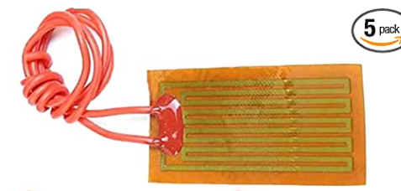
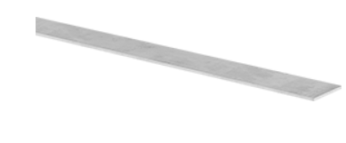
Materials
Heating element: https://www.amazon.com/Harissess-Flexible-Polyimide-Adhesive-25mmx50mm/dp/B09YLRMRF6/ref=sr_1_10?crid=KTCTHS6BJ1FM&keywords=thin%2Bflexible%2Bheating%2Belement&qid=1675189936&sprefix=thin%2Bflexible%2Bheating%2Belement%2B%2Caps%2C73&sr=8-10&th=1
Aluminum sheet (2x25x1ft): https://www.mcmaster.com/9146T15/

Slide 3
Encasement testing
Liquid UV resin can be cured strongly to UV resin fully cured items.
Will UV resin cure to PLA strongly?
Is strength enough for encasement?
Appears to give enough for encasement, but lacks bonding strength for anything structural

